Slide 1
World English
The UW Oshkosh TESOL Certificate Program
Caitlin Cobb, Suyeong Jo, Jongho Kang, Don Hones

Slide 2
Program Rationale
Prepare college graduates to teach English abroad
Prepare international teachers of English with additional coursework to support English programs in their home countries

Slide 3
Program Objectives
The TESOL Certificate program will support participants to
Become more knowledgeable about culture, language and learning
Gain readiness to select or adapt curriculum and pedagogy to meet the needs of culturally and linguistically diverse learners
Prepare to contribute to international communities by building bridges of understanding between the United States and other countries

Slide 4
Course Sequence
A sequence of three courses (9 credits) at the graduate level and four courses (12 credits) at the undergraduate level is needed to complete the TESOL certificate.
Introduction to Linguistics
Methods of ESL(EFL)
TESOL Practicum (undergraduate) OR International Practicum (graduate)
In addition, undergraduates will choose from one of the following electives:
Culture and Community Change in Costa Rica
Hmong Language, Culture and Learning
Anthropology
Other approved elective

Slide 5
Program Participants, Initial Group
Seven graduate students (teachers from Korea)
Three undergraduates
Linguistic diversity of participants (L1): Arabic, Korean, Spanish, and English

Slide 6
Program participants in ESL Methods

Slide 7
Perspectives: Suyeong Jo
Korean Elementary School Teacher
Graduate Student in Educational Leadership
Practicum Placement at Oshkosh Elementary School: daytime and after school
“I had taught for ten years in South Korea before I came to the US. One of the reasons I came here is I want to be a better teacher. As time goes by, I have had feelings of inadequacy in my teaching. I spent most of the time last year surviving in the US, so honestly it was hard to look back at myself as a teacher. Currently it is an excellent opportunity to reflect on myself as a teacher as I work as a volunteer at the school.”

Slide 8
Perspectives: Suyeong Jo
One of the students from the regular class just came to the US this summer from Iraq. She can understand what her teacher says in the classes and she can express her feelings or thoughts quite well but not fluently. She is struggling with reading and writing. I have worked with her once a week. The ESL teacher of the school gave me some resources to teach her. Most of the resources connected the words or terms which will be used in regular class, because the terms are not easy to understand for her. We played some games, and made some picture books to learn new vocabulary. At first, she seemed to enjoy the time with me. But she wanted to hang out with me as time went by. So I told her “Try to learn English with me, it is not a time to hang out with me.” After my words, she didn’t do anything with me until this week. I tried to talk with her, but she didn’t want to talk with me and didn’t want to listen to anything.

Slide 9
Perspectives: Suyeong Jo
If the students don’t have a good relationship with their homeroom teacher, the effects on the students are huge.
The relationship with the other student who came from Taiwan is getting better and better. He was very shy. When we first met, he didn’t say anything to me. I tried to have small conversations about his lunch menu, the funniest thing in the day, etc. I have tried to stay friendly with him. These days, he sometimes asked some questions about my day and even gave me a hug when we said goodbye. Also, he shows his best attitude as a student and follows my instructions very well. Actually, when he hugged me, I was full of happiness. I really enjoy the time with him, and I try to do my best when I help him.

Slide 10
Teaching English with Immigrant Students in Oshkosh

Slide 11
Perspectives: Suyeong Jo
I realize the importance of positive relations with students. If teachers and students make good relationships with each other, it will lead to a positive effect on teaching and learning. Especially for students who have lots of obstacles for learning such as ESL students, the impact of a good relationship with teachers is much greater than others.

Slide 12
Perspectives: Suyeong Jo
Reflections on the TESOL certificate program:
Through the work on the TESOL certificate, I can look back on myself as a teacher, especially as an English teacher. From the ESL Methods class, I could review and learn the various theories of teaching English such as SIOP model (Echevarria, Vogt, Short, 2013). Also, I could learn the principles of English in Linguistic class. Especially in Linguistic class, I could learn lots of aspects of ESL teachers on teaching English through class discussion. It was a fantastic chance to understand and know the current issues in ESL education. Through the practicum, I could learn how the ESL teachers try to teach their students effectively in their field. I have an opportunity to apply the theories or methods of teaching English as well. Above all, I could feel how the students feel struggles when they are learning English, and how the teachers try to help their students.

Slide 13
Perspectives: Suyeong Jo
South Korean students are in an EFL (English as a Foreign Language) setting. The students are working hard to learn English and teachers try to fit their needs as well. But many students give up learning English at an early stage because of the stress of learning English through tests, or memorizing vocabulary or grammar, and the students think they are not good at English.
The Korean Education office has made an effort to change the ways of teaching English, but I think one of the biggest reasons for students’ struggles is there is no chance to apply English in a real situation. The only way to use their English or check their English level is to take a test. Therefore, if they fail to make a good mark on tests, they lose their confidence in using English.

Slide 14
Perspectives: Suyeong Jo
One of the remarkable things which I found when the ESL teachers teach their students, the teachers try to set a goal for each student depending on the student’s English level. Also, the teachers assess the student’s English level through a variety methods, not depending on a standardized test. It is not easy to apply this in South Korea, but it gives one a lot of implications to think about.
I can not find the answers to teaching English in South Korea up to now, but I can find lots of resources from the course of the TESOL certificate. Also, I have lots of chances to share thoughts on teaching English with ESL teachers as well. Above all, I have a chance to compare the method of teaching English between the US and South Korea, and I can think about the problems and solutions more seriously and actively.
Therefore, the TESOL certificate program is a great opportunity to make a step further in my growth as an English teacher.

Slide 15
Perspectives: Jongho Kang
Korean Elementary School Teacher
Graduate Student in Educational Leadership
Practicum Placement at Oshkosh Elementary School, daytime and after school

Slide 16
Sheltered Immersion Techniques

Slide 17
Perspectives: Jongho Kang
In most cultures, it is uncomfortable to ask again about what people are saying. People pretend to understand others even if they do not understand. As an ESL student, I also have been doing the same thing whenever I do not understand others. This strategy was working in most of the usual conversations, but not for studying. Actually, it was hindering me from true learning. I can find my reflections in classrooms. I cannot do my study by fake communication with peers and professors, or I will fail to communicate with them.
The fake communication makes students bored in the classroom. Some of the students just sit at their chairs, doing nothing. The students who do not understand teachers` explanation seem to think a class is a torture for them. The language barrier makes many students intimidated or over-react.

Slide 18
Perspectives: Jongho Kang
Reading is especially challenging for the students. I know all of the students suffer during reading. But there is an apparent distinction between EL students and others. In my observation, their reading levels seem to be 2 to 4 grades lower than their peer group. They usually do not have family support for the reading, since their parents have no time to help them or parents are also not good at reading.
Time also matters for students. Teachers express empathy and support for the students, but they have responsibility for teaching all students in the classroom. They cannot spend all of their time helping the English Learners. That reality makes EL teachers special in a school. Their support and teaching completes the students. I could not forget the eyes of the students when I first met them in the classroom. I could remember passion of learning in their eyes.

Slide 19
Perspectives: Caitlin Cobb
Art major, Spanish major
Although I am now aiming to get my TESOL certificate, it did not start that way. I am in my final semester at UWO as a BFA and Spanish major and veered off to join the ESL program for the last bit of my college career.
As an Art major I am very limited in what I could do professionally as the market for artists is flooded and difficult to find a niche in. I have had an opportunity to work in a gallery, both on campus and off, and seriously enjoyed the experience. But I am more than just my art. Since I am an art major, it can be misconstrued as I am only interested in art. But that is a lie that also undervalues art, which is honestly a study of culture and history.

Slide 20
Perspectives: Caitlin Cobb
My Spanish degree is used for communication and to grant access to resources limited by my location and primary language. Sadly, I had to enter the higher level classes in order to discover holes in my education about the world, and thus find how limited the American worldview is.
In these TESOL courses I have found greater contact between cultures. I do not need to learn another language on top of the two to three that I know and am currently studying, but rather talk in a safe environment about issues that are often disregarded. Our goal is to communicate, albeit in English, but communicate about serious topics and how to apply them to children from a spectrum of backgrounds.
Currently I am planning on working abroad, and this certificate is a means to access more culture in depth. It is a chance to exchange ideas with those from other backgrounds and to learn their history while respecting them as individuals taking the time to learn my language.

Slide 21
Excerpts from a Practicum Journal (Seong Uk, Korean Teacher)
I want to focus on the teacher’s interaction with the boy who didn’t speak at all. During one class, the teacher gave only one verbal feedback to him: she said his name to point him out to as a model for other students to show how he cleaned up well. I hardly saw any non-verbal feedback from her. I think the reason is the teacher spent most of the time handling the students who had some misbehaviors.
I observed how he communicated with other students. While he did group activity in the class, he didn’t say anything. He just did his activity by himself even when one of his group members asked him something. Occasionally, he passed some materials which other students needed and helped his friends, but there were no words.
I tried to talk with him as well, but I couldn’t. Even though he spoke not at all, I made an effort to give a different version of feedback to encourage him. Nevertheless, he didn’t say anything in the whole class. I wonder why he didn’t speak at all. I want to know how he would be affected by me if I gave frequent feedback and showed him that I am interested in him.

Slide 22
Resourcefulness, Relationship, Respect

Slide 23
Ubuntu
“Ubuntu”, and expression from South Africa: I exist for you, you exist for me, and we live together. I thought of this when I first met Thomas and he pulled up a chair for me and the fact that he liked to learn about something with his classmates even if his English was poor.
- Seong Uk, Korean English teacher

Slide 24
Themes in Participant Reflections
Participants value opportunities to study and discuss topics of second language acquisition with other teachers
Participants value an introduction to methods of sheltered immersion
International participants value opportunities to volunteer with EL students and make cross-national comparisons of English teaching practices
There is great value found in resourcefulness, relationship, and respect—especially in relationship building (Hones and Cha, 1999)

Slide 25
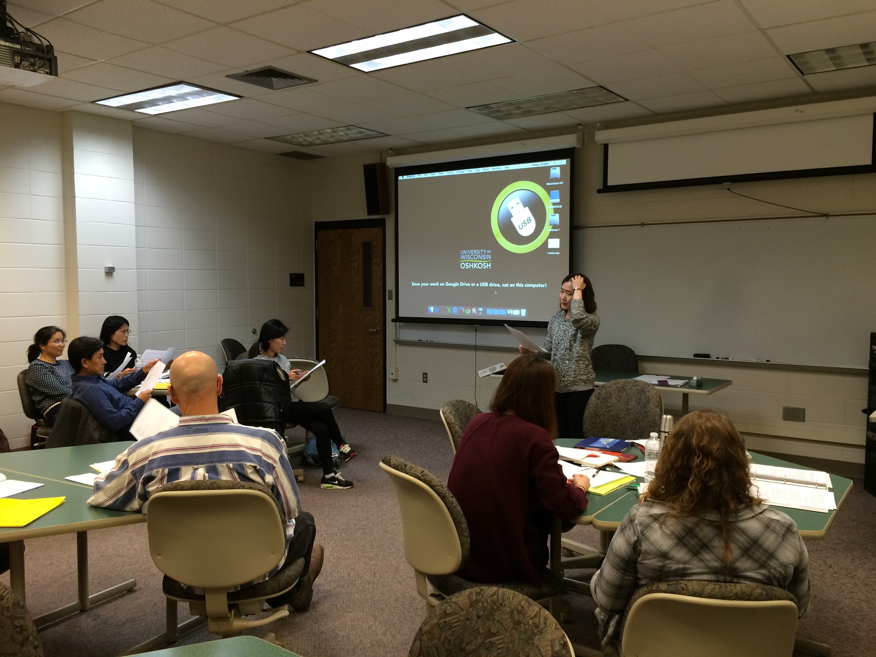
The Journey
This certificate is a journey into new lands, with diverse people to meet and a multitude of experiences to enjoy.
- Caitlin Cobb

Slide 26
References
Echevarria, J., Vogt, M. and Short, D. (2013). Making Content Comprehensible for English Learners: The SIOP Model. Upper Saddle River, NJ: Pearson.
Freeman, D. and Freeman, Y. (2014). Essential Linguistics: What Teachers Need to Know to Teach ESL, Reading, Spelling, Grammar. Portsmouth, NH: Heinemann.
Hones, D. and Cha, S. (1999). Educating New Americans: Immigrant Lives and Learning. Mahwah, NJ: Lawrence Erlbaum.
Snow, D. (1996). More Than a Native Speaker: An Introduction to Volunteers Teaching Abroad. Alexandria, VA: TESOL.

